Slide 1
Imagine a Government
Run By People, Not Money
Notes:
Thank you for having me today. My name is Laura Knipmeyer and I’m the volunteer state coordinator for the national cross-partisan organization American Promise. We are focused on the problem of big money in politics and an Amendment to the Constitution to fix it.
Today I’m going to speak about this problem, why an Amendment is the solution, and incredible progress with our strategy to win it.
With such an active group like yours –I’m curious:
How many have ever met with their MOC?
Have you written LTEs or or opinion pieces that have been published?
Maybe a journalist has written an article about your group?
That is FANTASTIC.

Slide 2
Equal Citizens
Equal Representation
Human Liberty
Effective Self-Governance
Notes:
Our organization is called American Promise.
What IS our American Promise? What do we mean by that phrase?
We mean
We are all equal citizens
We are entitled to equal representation
We believe in human liberty
And we strive to achieve effective self-governance
Those are values we all believe in, whether we’re Democrats, Republicans, or Independents.

Slide 3
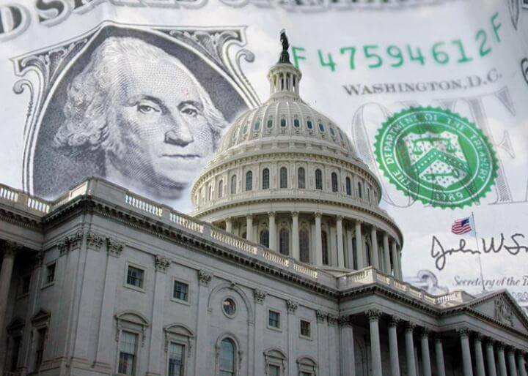
Notes:
There’s a problem in our democracy though: the influence of Big Money. Our system is WAY out of balance. Those with more money have more political power. They get to buy more representation and extra rights than the rest of us.
Money from wealthy special interests drowns out the voices of ordinary citizens. Big money is producing policy outcomes that fail to address the needs and concerns of ordinary people. What might those be?:
Health care & the opioid crisis
Student debt
Fairness in consumer credit
Housing
Clean water & air, Food Safety
Climate change
Gun safety
Innovation and competitiveness of American business
While we share these American values, we may differ in the particular issues we’re most concerned about. Let me tell you about some issues that brought me to this work.

Slide 4
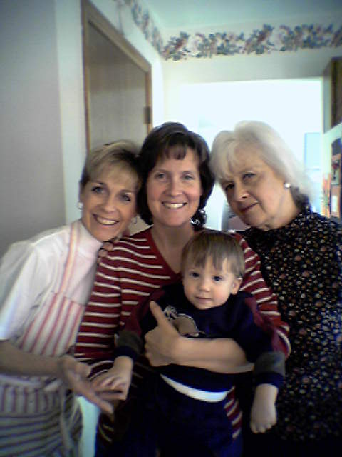
Notes:
This is a picture of my sisters and my Mom on Thanksgiving about 20 years ago. My nephew Ben was a year old. The next summer we had a vacation together on Martha’s Vineyard. We are having lunch on a jetty in the harbor there.
Now however, the piers and landings on the Vineyard are being re-built 5 feet higher because of climate change. Sea levels are rising so the coastline is changing. Who knows if you can sit on those jetties. I know that the influence of big money has prevented Congress from taking effective action to address climate change. So I work on big money in politics because I’d like to have policies reflecting the wishes of citizens in our democracy instead. Like those of my 17 nieces and nephews—these boys are getting married now—and to preserve a future for their children.
So how did we get here?

Slide 5
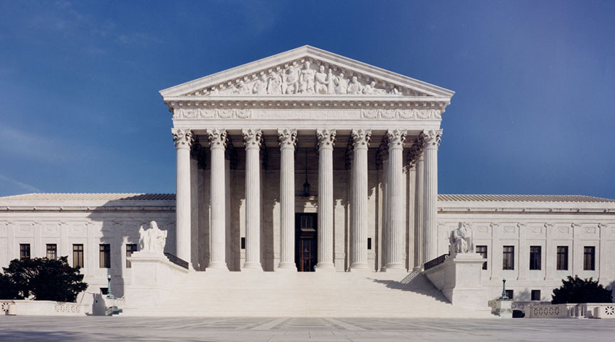
Money = Speech
Corporations = People
Notes:
In a series of cases, including Citizens United, the Supreme Court has undertaken a very damaging interpretation of the First Amendment. The Court said that money spent to influence elections is speech. It said that corporations are people with the same constitutional rights as natural persons, including free speech rights. It put those ideas together to rule that wealthy individuals and corporations can spend as much as they want to influence the outcomes of our elections.
This has caused money in politics to explode. It puts our politicians in a perpetual campaign cycle and forces them to spend half of their time raising money for re-election.
Because the Supreme Court has ruled this way, a constitutional amendment is required to fix it.
We need to preserve the First Amendment, rescue our politicians from the money arms race, and reclaim our democracy.

Slide 6
Three Money Problems
Big Money
Dark Money
Foreign Money
Notes:
When we talk about money in politics, we’re talking about three related but distinct problems:
Big Money
Dark Money
Foreign Money
I’m going to focus today on big money, the one we can ONLY fix with an Amendment.

Slide 7
Wealthy Individuals
A Tiny Elite:
0.47% of Americans
Delivers a Hefty Sum: 71%*
*Out of all individual contributions to federal candidates, PACs, parties and outside groups.
Under $200 total
$200+ total
Notes:
There is a wealthy donor class that provides the vast majority of campaign financing. This data is from the Open Secrets website and pertains to federal elections in 2018:
Donations from only 0.47% of Americans made up 71% of contributions by individuals to federal candidates, parties, PACs and outside groups.
This raises the question: what are the priorities of this donor class, and are they the same as the priorities of the majority of citizens?
Under current law we cannot limit the contributions of these individuals to outside spending groups like SuperPACs.

Slide 8
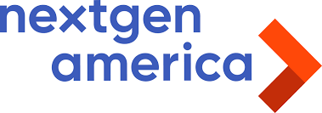
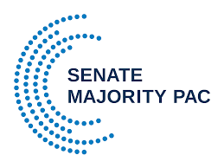
SuperPACs
Raise & spend unlimited sums
“Independent” expenditures
Required to disclose donors
Notes:
Big money doesn’t just come from wealthy individual donors, it comes from corporations, too. Corporations can’t donate to candidates’ campaigns, but under Citizens United they’re able to donate unlimited amounts of money to SuperPACs, and the SuperPACs can, in turn, spend unlimited amounts of money to influence the outcome of elections.

Slide 9
Dark Money
501(c)(4) Social Welfare Organizations
501(c)(6) Trade Associations
Not required to disclose donors
Notes:
Under the Citizens United decision, corporations and individuals can also donate unlimited amounts of money to Dark Money groups: social welfare organizations and trade associations created under section 501(c) of the Internal Revenue Code. These organizations can spend unlimited amounts of money to influence the outcome of elections. They are called dark money groups because they are not required to disclose their donors.

Slide 10
Notes:
Let me give you an example of how this works. Let’s say there’s a Congressman who wants to serve his constituents. They are particularly concerned about gun violence and they want him to do something.

Slide 11
Notes:
There was broad support in his district for background checks, and he wanted to vote for the Bipartisan Background Checks Act of 2019.

Slide 12
Notes:
But there was a wealthy individual who opposes any kind of restrictions on gun ownership. He didn’t live in our Congressman’s district, but that doesn’t matter. This wealthy individual meddled in Congressional races around the country. So what can he do?

Slide 13
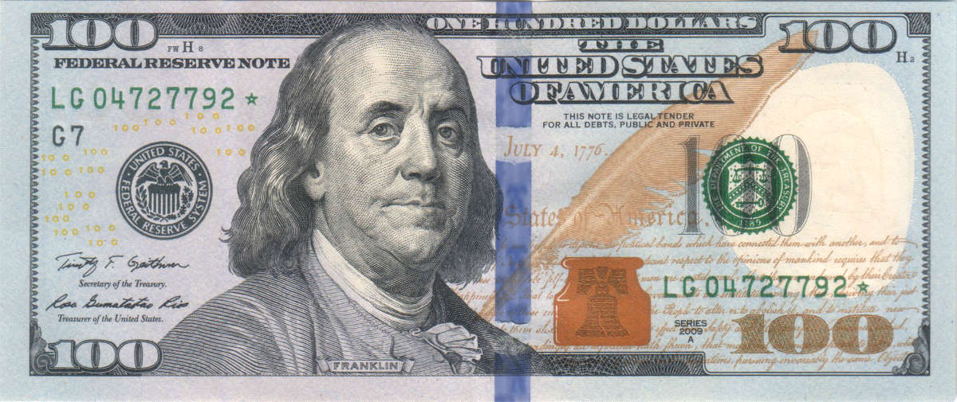
Opponent
Super PACs
$2800 limit
“Independent” Spending
No limit
No limit
Donors disclosed
Dark Money 501(c) Groups
No limit
Donors not disclosed
“Independent” Spending
No limit
Notes:
[A] He can make the maximum allowable donation to our Congressman’s opponent in the general election, and also to his opponents in the primaries. But that’s chicken feed to this individual. He wants to do more.
[B] He can give an unlimited amount of money to Political Action Committees.
[C] He can also give unlimited amounts of money to dark money groups.
[D] Finally, he can spend an unlimited amount of his own money on TV, radio, newspaper and social media ads as long as they are independent expenditures.
[E] PACS, dark money groups and wealthy individuals can ALL spend unlimited amounts of money as long as those expenditures are “independent” of any campaign. This enables our wealthy individual to fund a lot of negative advertising against our Congressman.

Slide 14
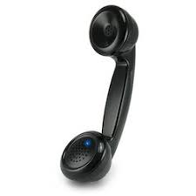
To Opponent: $2800
!!!!!!!
Super PACs
Dark Money Groups
“Independent” Spending
Notes:
So our individual makes it known to our Congressman that if the Congressman supports a background check bill, he is ready not just to give the maximum to our Congressman’s opponent, but to give money to Super PACS and Dark Money Groups, and spend his own money on YouTube videos, Facebook ads, and TV commercials. All this makes our Congressman think twice about voting for a bill that has overwhelming support in his district. But let’s say our Congressman is brave, and he’s committed to doing what his constituents want him to do. What does that mean?

Slide 15
Wealthy individuals
Friendly Super PACs
Notes:
It means he’s got to spend a lot of time at the party’s call center, dialing for dollars to build up his campaign war chest to get ready for the tsunami of money that’s going to be spent against him in his re-election campaign. He’ll ask wealthy individuals and PACs to contribute the maximum to his campaign, and he’ll court the support of friendly Super PACs that can engage in unlimited independent spending. And they’ll all be telling him what they expect in exchange for that support.

Slide 16
No limits
1st Amendment “Free Speech”
Super PACs
Limits Apply
Opponent
Dark Money 501(c) Groups
$2800 limit
“Independent” Spending
Notes:
[A] Under current law, the only piece of this picture we can control is the limit on donations to the campaigns of our Congressman’s opponents.
[B] We can’t place any restrictions on donations to PACs or dark money groups, or independent expenditures by those groups, or an individual’s own independent expenditures.
It’s all protected as First Amendment free speech. So its not possible without the Amendment to put any guardrails around all this money from corporations, unions, special interests and wealthy individuals – and to distinguish between them and natural persons (voters) in any state.

Slide 17
Center for Responsive Politics, www.opensecrets.org/outsidespending/
Notes:
Outside spending by wealthy individuals, SuperPACs and Dark Money groups has exploded since Citizens United. This is Open Secrets’ graph of outside spending to influence federal elections. It does not include spending by political parties.

Slide 18
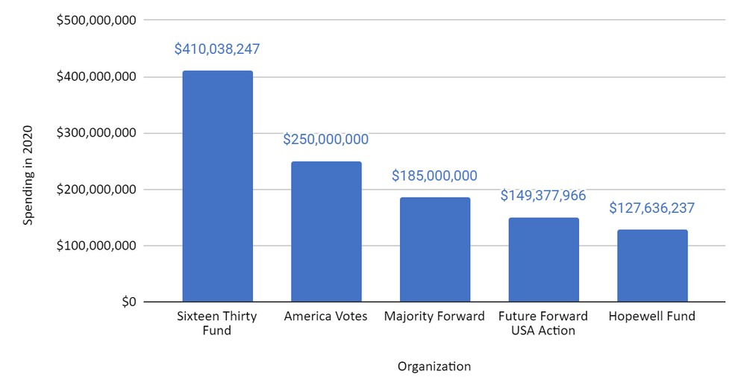
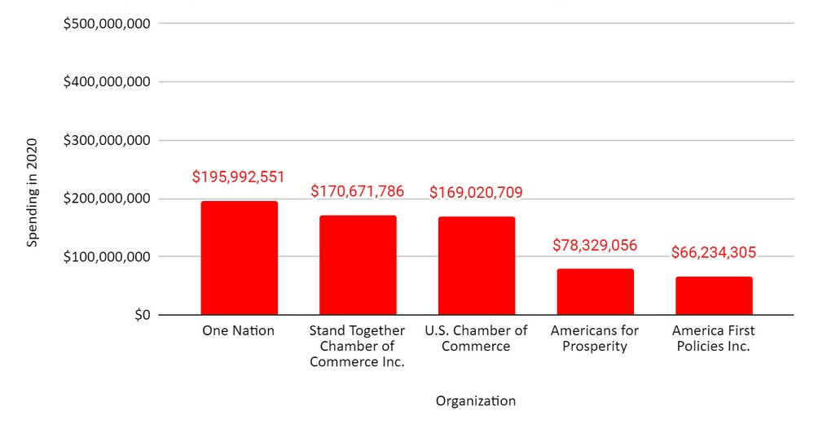
2020 Major Party Dark Money Funders
DEMOCRATIC SUPPORT: $1,725,759,799
REPUBLICAN SUPPORT: $972,501,426
290
Data - New York Times
Notes:
In 2020 the money more than doubled to $15 billion. Dark money funders escalated on all sides.

Slide 19
Notes:
Let Ben Cohen of Ben & Jerry’s fame demonstrate big money in politics.

Slide 20
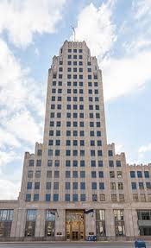
Unlimited “independent” expenditures
501(c)(4) or (c)(6) “Dark Money” corporation
Super PACs
X
Non-US persons incorporate
Unlimited donations
Unlimited donations
Unlimited “independent” expenditures
US corporation that conducts US operations
Does not disclose donors
Discloses 501(c) corp. as a donor
“John Paul Stevens Was Right: Citizens United Opened the Door to Foreign Money in U.S. Elections”, by Jon Schwarz, The Intercept, July 18, 2019
Notes:
The Supreme Court has also made the problem of foreign money in our elections worse. It’s still illegal for foreigners to donate to U.S. campaigns. But foreign money is making its way into the system through U.S. corporations. Here’s how it works:
Non U.S. persons create a U.S. corporation that does business here.
That corporation can use the proceeds of that business for dark money groups – as we have just seen.
And we can’t place any limits on the spending by those groups to influence our elections.

Slide 21
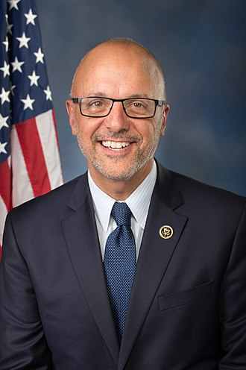
H. J. Res. 1 by Deutch:
“May” regulate and set reasonable limits on raising and spending of money by candidates and others
“May” distinguish between natural persons and corporations
Companion:
S. J. Res. 25 by Shaheen
Notes:
So we are going to fix this by passing a constitutional amendment. That requires 2/3 of the U.S. House, and 2/3 of the Senate, to pass the exact same language. Then ¾ of the states – 38 states – have to ratify it.
Here’s an example of language that has been introduced this session of Congress: H. J. RES. 1 by Deutch, which has 88 co-sponsors, including Rep. John Katko (R-1-NY). The companion in the Senate, S.J. Res 251, has 25. In California, this bill was previously co-sponsored by 40/53 representatives.
There are about 10 other versions which have been introduced previously and new versions For Our Freedom, which or which are under discussion now. Its an exciting time as there is wide-spread cross-partisan support.

Slide 22
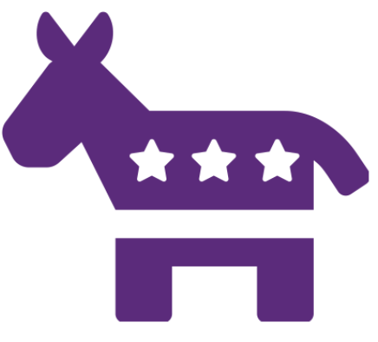
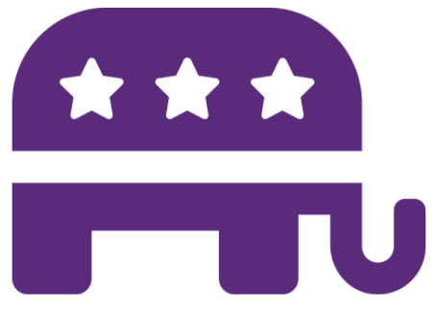
On the Bright Side: A Groundswell for Change
Who supports the For Our Freedom Amendment?
75%
of Americans
70%
of Independents
85%
of Democrats
Source: Univ of Maryland Study, 2018
72%
of Republicans
Notes:
What makes us optimistic that the 28th Amendment is possible is polling showing strong bipartisan public support for reform. This is from a 2018 University of Maryland poll that found a strong majority of Americans of all political persuasions support a constitutional amendment to address money in politics

Slide 23
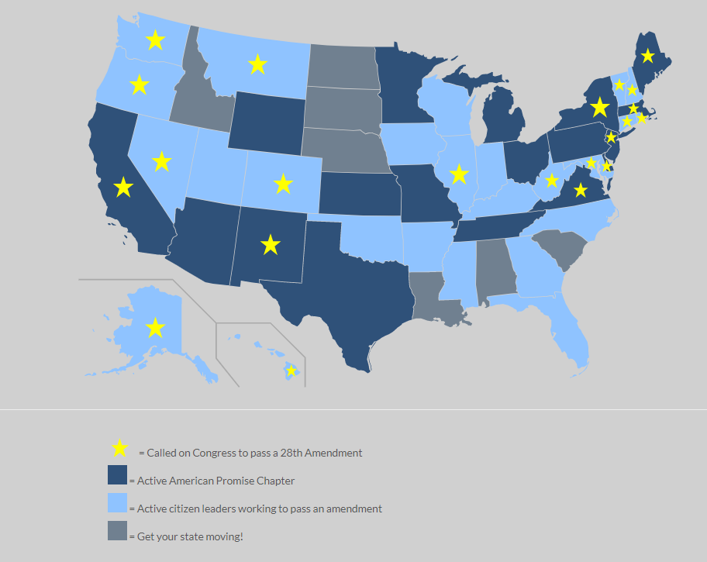
Notes:
Another reason to be optimistic is how much progress has been made across the country in calling for the Amendment in 12 short years: 900 cities and towns and 22 states have called for this amendment. Our members are working to develop citizen leaders in every state to prepare for ratification in at least 38 states very quickly once the amendment is passed in Congress.

Slide 24
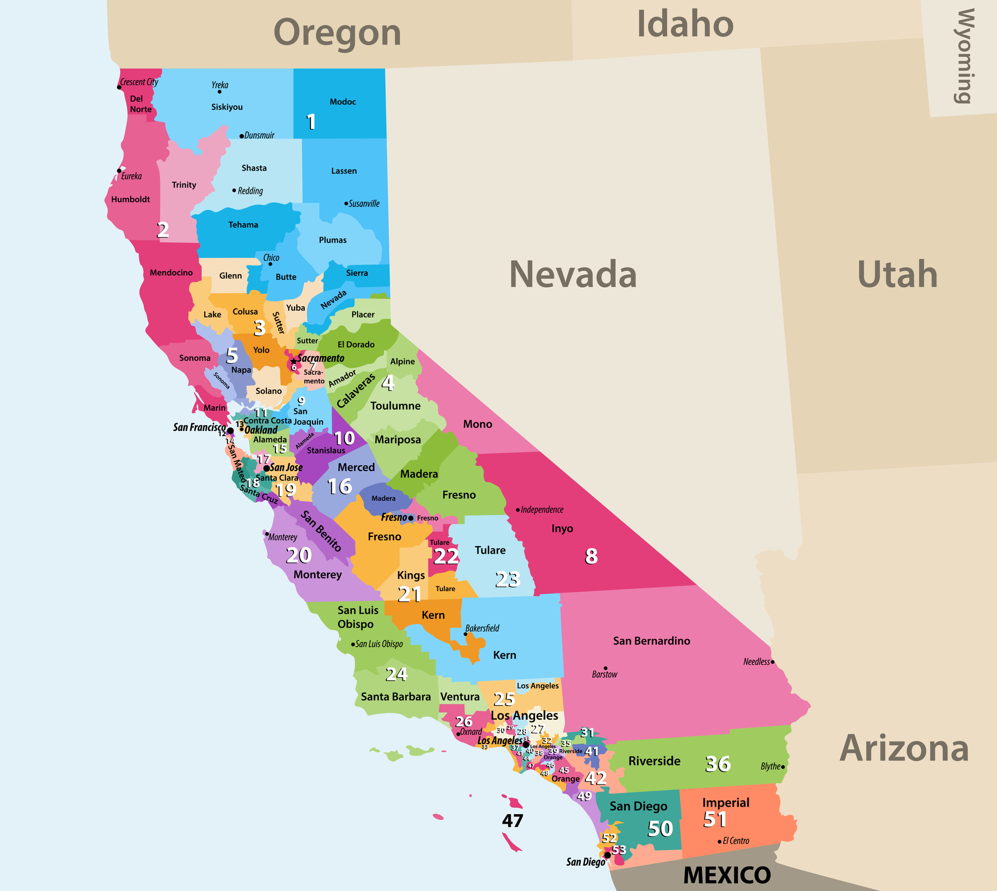
m
American Promise California 2022
52 Congressional Districts
m
Notes:
Across California we have mostly-supportive members of Congress. That is great. In now 52 districts, 43 of them have been actual co-sponsors of the amendment in the last session of Congress. The most important hurdle we face is building the cross-partisan support we need to pass this amendment.
Right now we are singularly focused on our Candidate Pledge.
Signing as many Republicans as we can and getting media coverage to distinguish between the candidates before the primary.
This is esp. important in April 2022; 14 districts are key to making the amendment a voting issue in 2022.
American Promise offers specific training for others too, in 3 areas
Meet with members of Congress,
2) build community support through presentations like this, educating voters for members of Congress, and
3) publish media that influences both members of Congress and voters to act.
American Promise’s goal is to have the constitutional amendment passed out of Congress by 2022 and ratified by the states by 2026. Quite possibly the new Congress can pass the Amendment in 2023.
Our teams are cross-partisan, and respectful--which means we are Democrats, Republicans and Independents working together on an issue we agree on, based on shared American values.
I invite you to help, and to have fun becoming a trained and articulate citizen leader to reclaim our democracy.

Slide 25
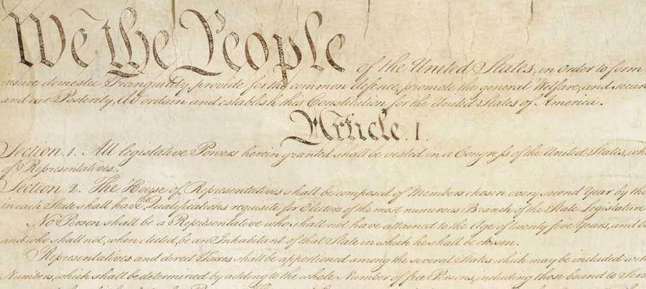
Notes:
What kind of democracy can we expect after we ratify this Amendment?
We think it will be a democracy where we have more speech, more ideas, less polarity(!) more candidates, more participation, less cynicism, and better representation.
We’ll have a clear line between the rights of corporations and the rights of human beings.
And we’ll be closer to our American Promise of equal citizenship and effective self-governance.
I hope you’ll join us. I look forward to answering your questions.

